Slide 1


Slide 2

FITZ-THORS MECHANICAL
FTM Services Include:
Fitz-Thors Mechanical, Inc. provides design, development, and consulting services to various industries. The company’s primary focus is in developing custom mechanical equipment and systems. With design offices in Vance, Alabama, Fitz-Thors Mechanical can offer comprehensive services to develop your mechanical solutions from design to delivery.
Advanced mechanical modeling, simulation, and analysis with SolidWorks 3D CAD design software
Full Service Machining and Fabrication Capabilities
Production Machining
Prototype Development
Process Automation and Control Systems
Turn-Key Solutions
Custom Material Handling Equipment
Test/Assembly Fixtures
Equipment Installation and Maintenance

Slide 3
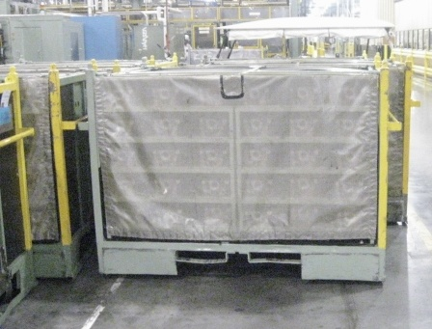
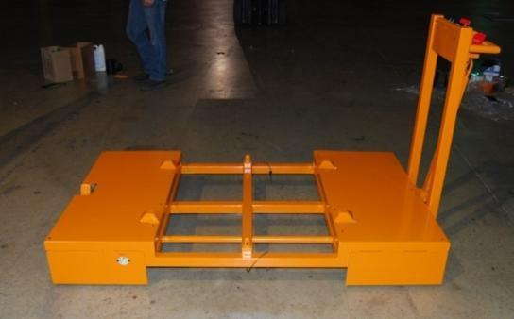
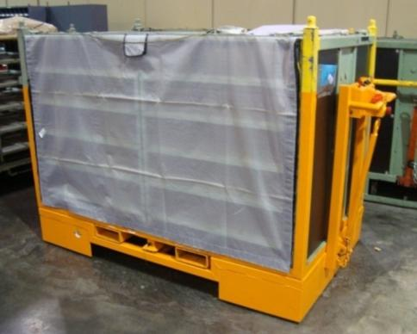
FITZ-THORS MECHANICAL
Electro-Mechanical Design
Original push/pull material handling cart.
Approx. weight full loaded 3,000lbs.
Requested design to address ergonomic issues with team members having to manually move carts.
FTM Base Cart
24V DC power base cart, with retractable drive wheel.
Programmable parameters include accel, decel, and breaking.
Self-locates rack for ease of loading and unloading of racks.
FTM Base Cart with Modified Rack
Maintains original cart footprint.
Capable of being coupled to other carts (by use of tow bar and hitch) and pulled by tuggers.
On board charging with standard extension chord and wall outlet.

Slide 4
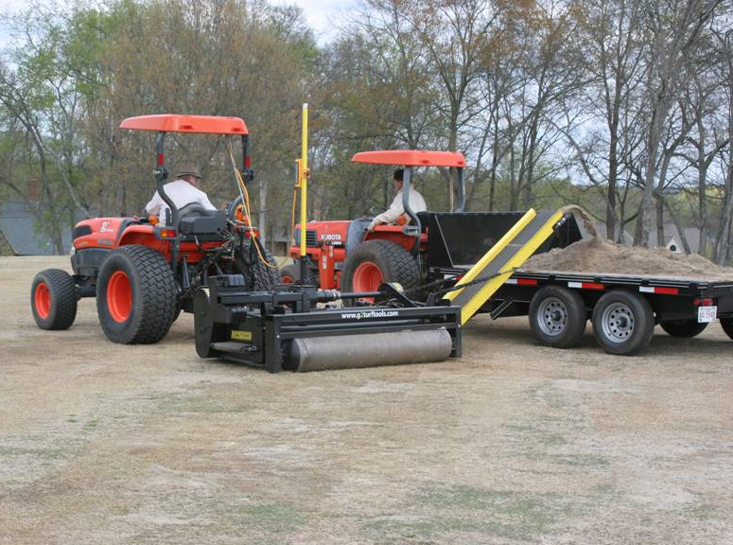
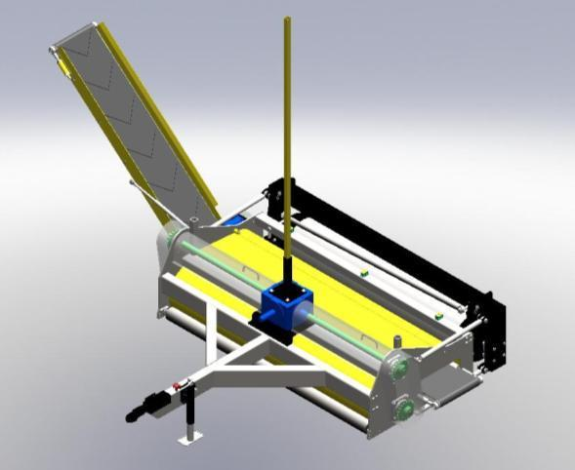
FITZ-THORS MECHANICAL
Product/Prototype Development
Fitz-Thors Mechanical worked with G2Turf Tools to develop a specialized cutting head and safety features for their TurfPlaner, a new line of equipment for surface reconditioning and maintenance of high-end sports fields and golf courses.

Slide 5
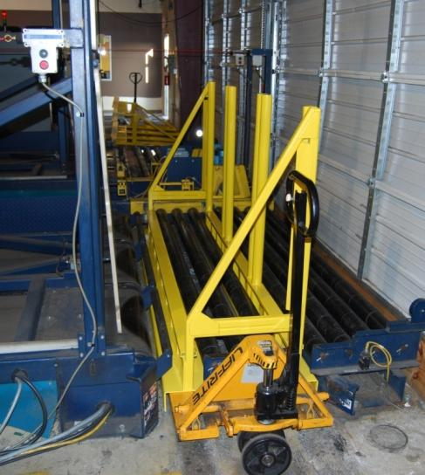
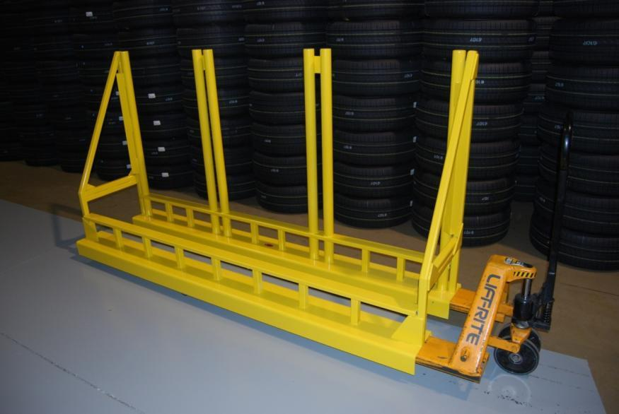
FITZ-THORS MECHANICAL
Custom Material Handling Equipment
Fitz-Thors Mechanical often works with customers to improve components that are considered weak links in existing systems.
Fitz-Thors performs design optimization using Finite Element Analysis in SolidWorks to maximize equipment strength for given packaging constraints. This ensures our fabricated equipment can handle customers demands and reduce maintenance requirements.
Fitz-Thors Mechanical designed and fabricated equipment used in automation system to load wheel assemblies into distribution trucks for Mercedes-Benz.
The customer’s previous equipment could not withstand the heavy cyclic loading and had become a continual maintenance issue.

Slide 6
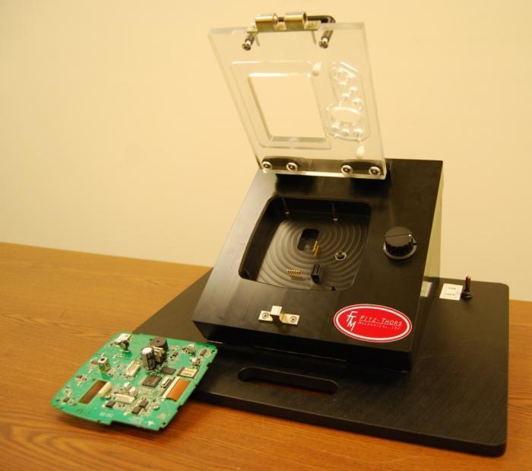
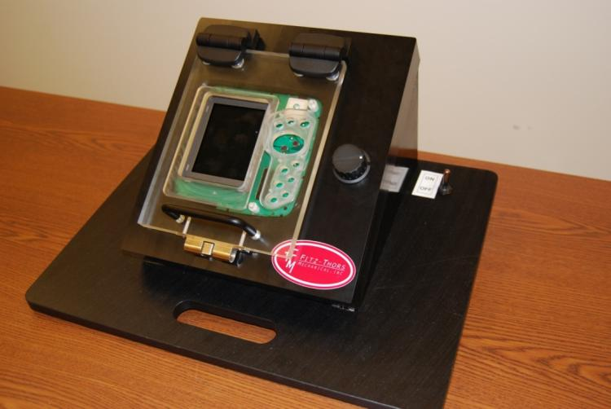
FITZ-THORS MECHANICAL
Custom Test Fixtures
Fitz-Thors Mechanical designed & fabricated electrical test equipment for Johnson Outdoor’s Humminbird division to eliminate component damage and increase overall product throughput.
The showcased fixture eliminated several tedious manual tasks by combining locating, probing and adjustment into one convenient place and test device.

Slide 7
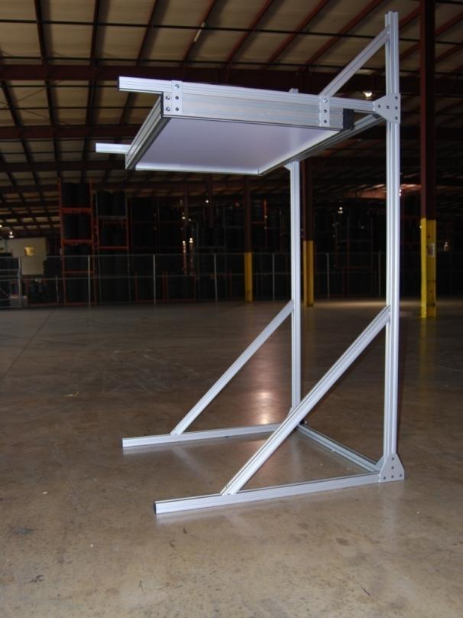
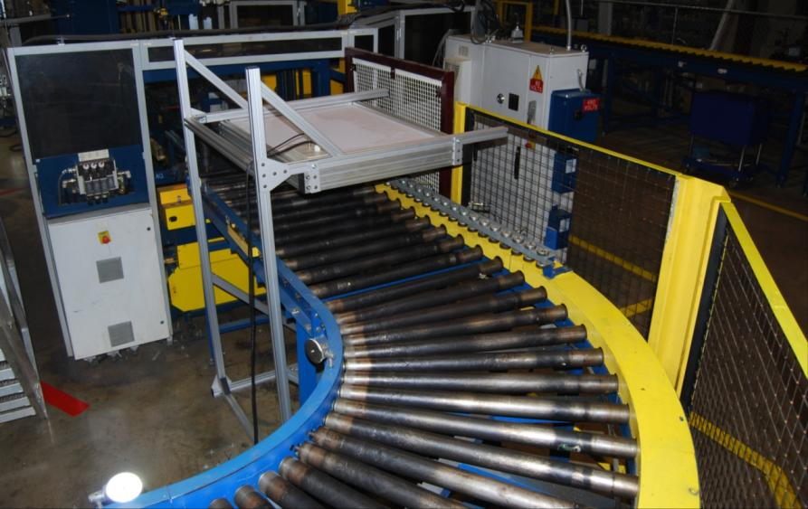
FITZ-THORS MECHANICAL
Data Collection and Senor Equipment
Designed and developed product to actively test and record proper operation on critical sensors that monitor vehicle tire pressure for newly assembled wheels and tires.

Slide 8
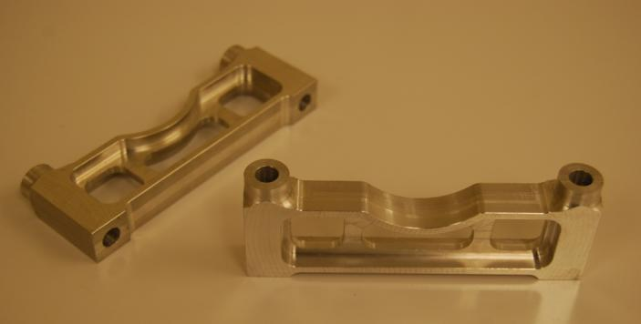
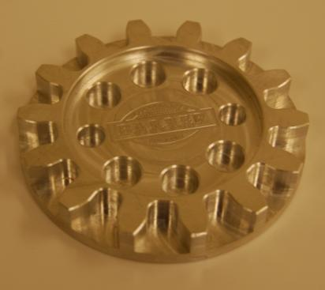
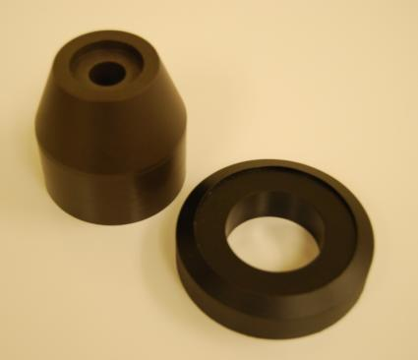
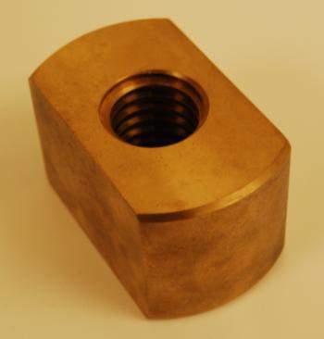
FITZ-THORS MECHANICAL
Specialized Machining
Fitz-Thors Mechanical has in-house high speed CNC machining capabilities. Our machines use Renishaw wireless probing to perform part and tool offsets, in addition to part inspection and tool wear detection, to ensure the highest possible quality and repeatability of machined parts. Fitz-Thors has experience in machining various materials and can handle quantities large or small.
Break Caliper Mounts for Citation Engineering
Aluminum sprocket with engraved logo
Delrin and Acetal Parts for Non-abrasive applications
MIL Spec bronze casting machined for US Military

Slide 9
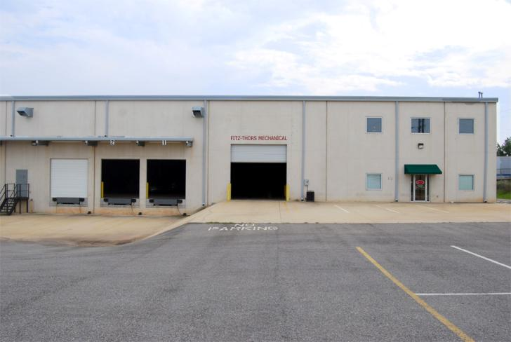
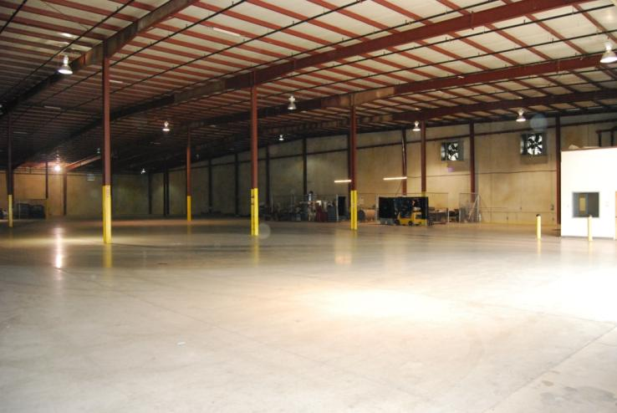
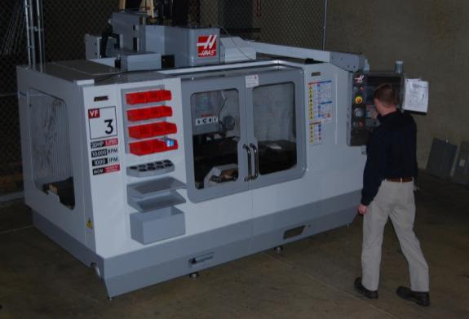
FITZ-THORS MECHANICAL
Facilities
Fitz-Thors Mechanical is located in the Brose Industrial park, less than one mile from the Mercedes-Benz manufacturing facility, in Vance, AL.
Our facilities complement efforts in design, fabrication, and testing by combining all services under one roof which includes a 2,000 ft² machine shop & 30,000 ft² of open warehouse space that can accommodate any size project.

Slide 10
Company Information:
Fitz-Thors Mechanical
10097 Brose Drive, Suite 100
Vance, Alabama 35490
Toll Free: (888) 470-1652
Fax: (205) 383-4430
Email: info@Fitz-Thors.com
Website: www.Fitz-Thors.com
DUNS#: 825172237 CAGE#: 56DN5

